Slide 1


WHAT WOULD THEY SAY?
Perspectives on the December 1914 Christmas Truces
Notes:
This slide show is a modified version of one made by Peter Sanderson, Joseph Swann Academy, for the Northumbria and Newcastle Universities Martin Luther King Peace Committee.
This slideshow is designed to be used in conjunction with the ‘Teaching the 1914 Christmas Truces Resources Pack’ for schoolteachers, available at www.mlkpc.org Please see the Resources Pack for the lesson that it accompanies, plus plans for other lessons, assembly and a carol service, all linked to the December 1914 Christmas Truces.
This work is licensed under a Creative Commons Attribution-NonCommercial-ShareAlike 4.0 International License. Feel free to copy and redistribute this work, and also to remix, tweak, transform and build upon it for non-commercial uses, giving appropriate credit to the original. For details see www.creativecommons.org

Slide 2
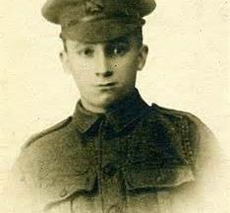
THE NEW RECRUIT
WHAT WOULD HE SAY?

Slide 3
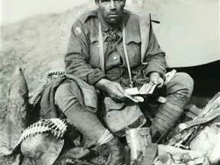
THE VETERAN
WHAT WOULD THEY SAY?

Slide 4
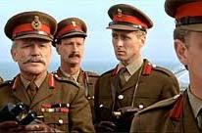
THE OFFICERS
WHAT WOULD THEY SAY?

Slide 5
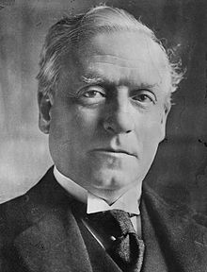

THE POLITICIAN
WHAT WOULD HE SAY?
Notes:
Herbert Asquith, Prime Minister 1908-1916

Slide 6
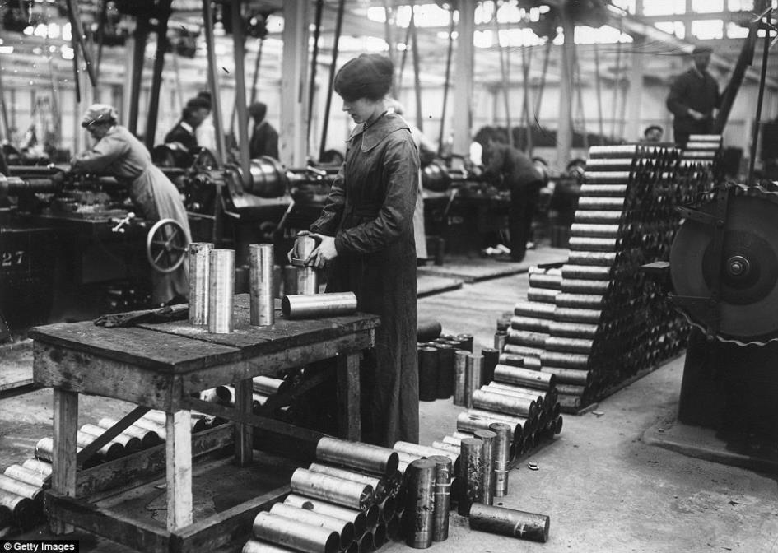
THE WEAPONS MANUFACTURERS
WHAT WOULD THEY SAY?
Notes:
Woman making shell cases in Vickers Factory, January 1915. Vickers made a range of weaponry including the main machine guns used by the British army and in British military planes in the war.

Slide 7
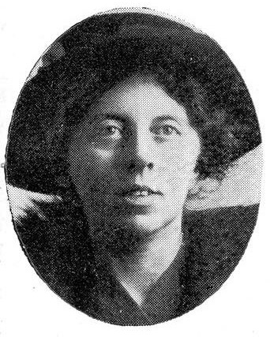
THE ANTI-WAR ACTIVIST
WHAT WOULD SHE SAY?
Notes:
A leading opponent of the war was Catherine Marshall, a member of the Women’s International League for Peace and Freedom. She was a suffragette, which means she campaigned for women to have the vote – at that time only men could vote in elections. She believed that war was against Christianity, and that women were more likely to find ways of settling international disputes without war than were men. When men were put in prison, women like her led the peace work in Britain.

Slide 8
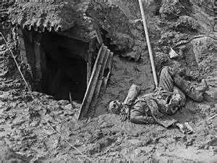
THE DEAD CAN’T SPEAK……BUT IF HE COULD?
WHAT WOULD HE SAY?

Slide 9
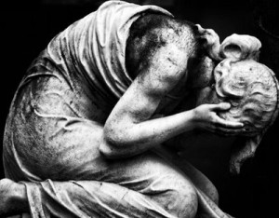
THE GRIEVING FAMILY
WHAT WOULD THEY SAY?

Slide 10
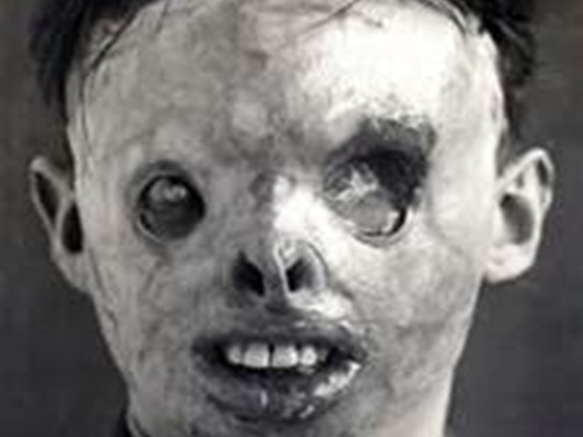
THE BADLY WOUNDED SURVIVOR
WHAT WOULD HE SAY?

Slide 11
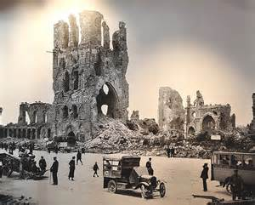
THE PEOPLE OF OCCUPIED FRANCE AND BELGIUM
WHAT WOULD THEY SAY?

