Slide 1


http://www.childrensfootballalliance.com/football-and-peace/

Slide 2





GLOBAL PEACE GAMES
2017
The GPGs is linked to Peace Fields Projects which aims to twin
school playing fields with Flanders Peace Field.
The GPG is funded by the European Union.
Countries taking part: Belgium, England and Italy.
Schools representing England:
The Abbey School, Faversham, Kent & Chailey School, Chailey, Sussex.

Slide 3

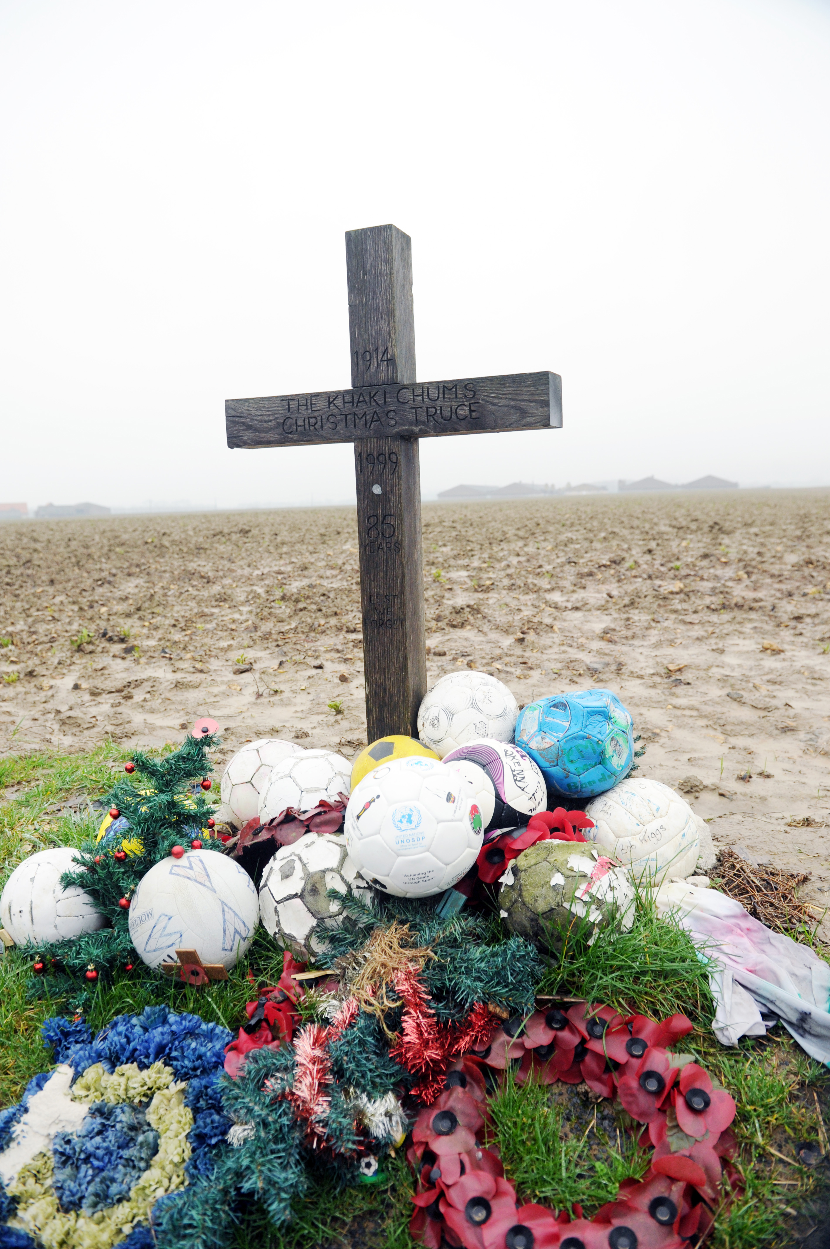
Then and now.
AIM
To commemorate the centenary of the First World War; The Global Peace Games (GPGs) brings young people together in a cultural exchange of learning. It enables young people to explore the role of sport; at home, in the community and in different countries; our global village.
As an integral module to The Peace Fields Project the GPGs will help contextualise young people’s perception of war. It will record their experiences and opinions, which they feel are relevant today - for future generations.
FLANDERS PEACE FIELD

Slide 4
DATES
Sunday 17th September
Welcome to the GPGs
Monday 18th September
Peace Fields Day
Tuesday 19th September
Peace Day Celebration
Wednesday 20th September
Commemoration Day
Thursday 21st September
International Day of Peace
Friday 22nd September
Football and Peace Day

Slide 5
Numbers
10 Participants (14-16 Years old)
Key Stage 4
5 girls – 5 boys
2 members of staff
One member of staff qualified to facilitate sports
(Touch rugby, cricket, football, cycling)

Slide 6
Accommodation and Food
All participants will stay at The Peace Village which is a peace education centre. All rooms accommodate 4 to 8 people.
There are 3 meals a day; breakfast, lunch & dinner. Please notify your teacher as soon as possible of any dietary requirements.
Strict rules:
Do not bring laptops, consoles, jewellery, personal artefacts or inappropriate clothing. The NCFA and Peace Village will not be responsible for replacing damaged or lost property.
Damage to property:
Any damage casued to The Peace Village property or facilities by any person or persons attending the GPGs will be held accountable to pay for the damage.

Slide 7
KIT LIST
Towels
Toiletries
Waterproof jacket + pants
Sportswear / shorts / top / trainers & football boots – NO BLADES
Walking shoes
Cycling helmets will be provided (however, if you wish to bring your own let your teacher know)
Spending Money; if you wish to buy souvenirs in Ypres, drinks or snacks then it is advisable to bring a maximum of 25 Euros.
Mobile phones: All mobile phones are the responsibility of the owner.
The GPGs Policy concerning mobile phones: Participants must hand their phones to their teacher before arriving at The Peace Village. Participants can use their phones after 7pm and then hand them back to their teacher the following morning before 8.30am.

Slide 8
TRAVEL
Travel 17th September, 2017.29 seat Midi Coach + P&O Crossing
Destinations: East Sussex / Kent to Messines, Peace Village, Belgium, Nieuwkerkestraat 9, B-8957 leper, Belgium.
First pick-up 03:00 am Chailey School, Mill Lane, South Chailey, Lewes, BN8 4PU
Second pick-up 04:45 am Abbey School, London Road, Faversham, ME13 8RZ
ARRIVE11.30 am Peace Village, Belgium, Nieuwkerkestraat 9, B-8957 leper, Belgium
Travel 22nd September, 2017.Destinations: Messines, Peace Village, Belgium, Nieuwkerkestraat 9, B-8957 leper, Belgium, to Kent / East Sussex
First pick-up 11.30 am Messines, Peace Village, Belgium, Nieuwkerkestraat 9, B-8957 leper, Belgium
ARRIVE17:00 pm Abbey School, London Road, Faversham, ME13 8RZ
ARRIVE18.30 pm Chailey School, Mill Lane, South Chailey, Lewes, BN8 4PU

Slide 9
IMAGE CONSENT FORMS
All pupils need their parents, guardians or carers to sign the image consent form before the trip and hand it in to their teacher. These forms can be obtained from the school’s teacher.
The Global Peace Games will be filmed by the NCFA. The short film will appear on the NCFA’s Football & Peace website
Online links with the Peace Village / Flanders Peace Field and NCFA’s Football & Peace website will have access to view the film.
Each school will have their GPG featured on their Football & Peace home page on the Football & Peace website.

Slide 10
 | Morning | afthernoon | Evening
Sunday 17 September | Welcome: England / Belgium / Italy / PEACE VILLAGE (PV) | Ice braeking session (NCFA) | March of the Phoenix (Peace Village)
Monday 18 September Peace Fields Day | Passchendaele MMP Tyne cot |  | Multi purpose games (England / Belgium / Italy)
Tuesday 19 September Peac Day Celebration | Cycling / Christmas truces (PV) | Cricket | The art of the communication (Pax Christie)
 | Touch Rugby (Abbey School)
Wednesday 20 September Commemoration Day | Graffiti Art | Cultural games Football (Chailey School) SPECIAL GUESTS 3p.m. – 7 p.m.: FC Bruges | Ypres Last post
Thursday 21 September International Day of Peace | Workshop Caritas International | Football (NCFA) Conflict resolution (NCFA) | Movie
Friday 22 September Football & Peace Day | Closing ceremony

Slide 11
EMERGENCY CONTACT NUMBERS
In case of any emergency contact the numbers listed below.
NCFA Director: Ernie Brennan + 00 44 (0)7813 082584
NCFA Manager: John Casey + 00 44 (0)7792068634
Peace Village: Matti Vandemaele + 00 32 (0) 57 22 60 40
All members of staff will have a register of pupils emergency contact details. If there is an emergency at home parents, guardians and carers, must contact the NCFA in the first instance.
http://www.childrensfootballalliance.com/football-and-peace/

