Slide 1
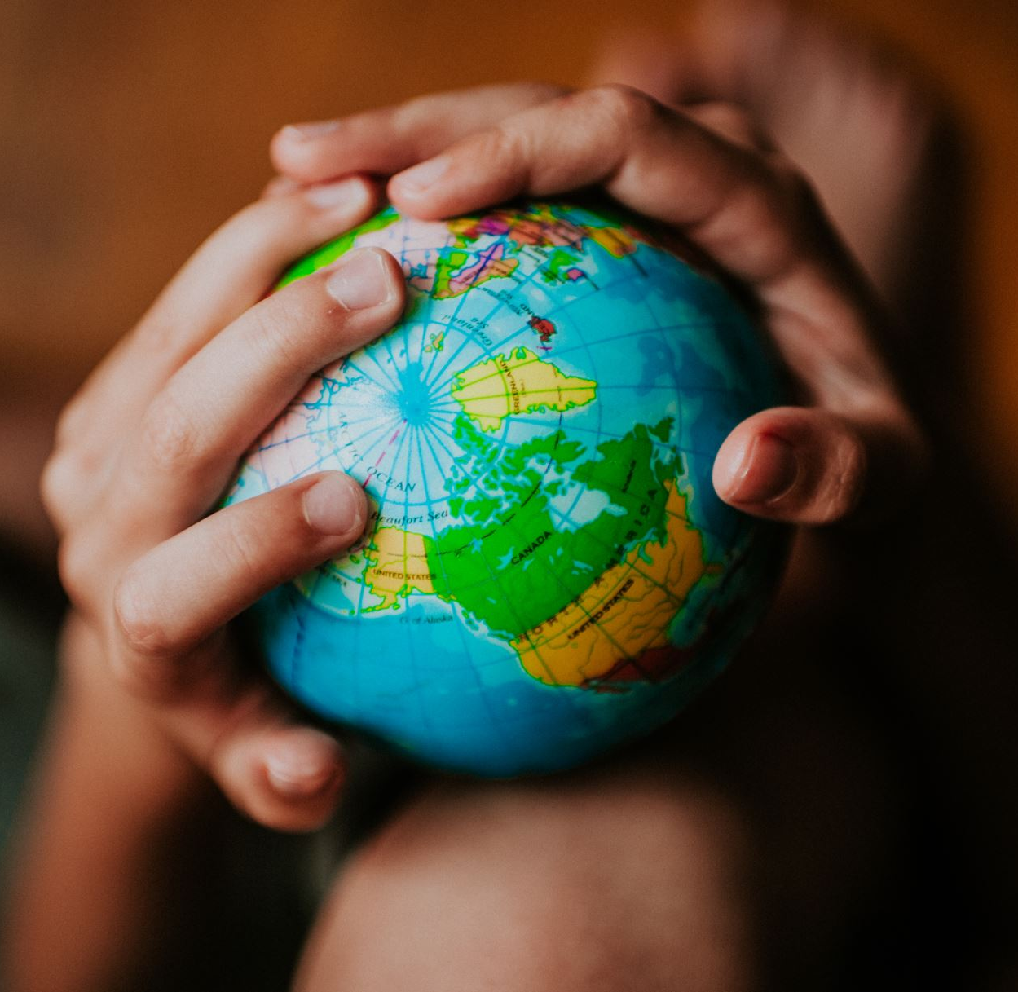
UN World Day of Peace
21 September 2022

Slide 2
UN World Day of Peace
Each year the International Day of Peace is observed around the world on 21 September. The UN General Assembly has declared this as a day devoted to strengthening the ideals of peace, through observing 24 hours of non-violence and cease-fire.
But achieving true peace entails much more than laying down arms. It requires the building of societies where all members feel that they can flourish. It involves creating a world in which people are treated equally, regardless of their race.

Slide 3
UN World Day of Peace 21 September 2022
Racism, xenophobia and related discrimination and intolerance exist in all societies, everywhere. Racism harms not just the lives of those who endure it, but also society as a whole. We all lose in a society characterized by discrimination, division, distrust, intolerance, and hate. The fight against racism is everyone’s fight. We all have a part to play in building a world beyond racism.

Slide 4
Fight Inequality, Fight Racism
In 1965, the international community adopted a convention by which they committed to eliminate all forms of racial discrimination. The Convention is now nearing universal ratification. Yet still, all around the world too many suffer from the injustice and stigma that racism brings.
International Convention on the Elimination of All Forms of Racial Discrimination

Slide 5
End Racism Build Peace

Slide 6
The Christmas Truce
Late on Christmas Eve 1914, men of the British Expeditionary Force (BEF) heard German troops in the trenches opposite them singing carols and patriotic songs and saw lanterns and small fir trees along their trenches. Messages began to be shouted between the trenches.
The following day, British and German soldiers met in no man's land and exchanged gifts, took photographs and some played impromptu games of football. They also buried casualties and repaired trenches and dugouts. After Boxing Day, meetings in no man's land dwindled out.
The truce was not observed everywhere along the Western Front. Elsewhere the fighting continued and casualties did occur on Christmas Day. Some officers were unhappy at the truce and worried that it would undermine fighting spirit.

Slide 7
The Christmas Truce

Slide 8
Personal Testimony
We were in the front line; we were about 300 yards from the Germans. And we had, I think on Christmas Eve, we’d been singing carols and this that and the other, and the Germans had been doing the same. And we’d been shouting to each other, sometimes rude remarks more often just joking remarks. Anyway, eventually a German said, ‘Tomorrow you no shoot, we no shoot.’ And the morning came and we didn’t shoot and they didn’t shoot. So then we began to pop our heads over the side and jump down quickly in case they shot but they didn’t shoot. And then we saw a German standing up, waving his arms and we didn’t shoot and so on, and so it gradually grew.

Slide 9
Personal Testimony
I remember very well Christmas, I remember the Christmas Day when the German and the French soldiers left their trenches, went to the barbed wire between them with champagne and cigarettes in their hands and had feelings of fraternisation and shouted they wanted to finish the war and that lasted only 2 days 1 and a half really and then strict order came that no fraternisation was allowed and we had to stay back in our trenches.
The Real Story Of The Christmas Truce Of 1914 | Imperial War Museums (iwm.org.uk)

Slide 10
The Christmas Truce

Slide 11
The Christmas Truce

Slide 12
The Christmas Truce and UN World Day of Peace
The Christmas Truce was a moment in the First World War when opposing soldiers came together for a couple of days and exchanged gifts.
Sadly, it did not last and would not be repeated. The war would last another four years and have millions of casualties.
We come together on 21 September to signal our support for Peace and to demonstrate our resolve against Conflict.
We also proclaim our determination to end Racism and all forms of Hate and Prejudice.

Slide 13
Twinning with the Peace Pitch in Flanders
The students of Year 9 have been involved in a project where they have researched and found out about significant football stories in the Mid-Ulster and beyond.
The last element of the project will involve a commemorative event on the school pitches.
Two students will speak to other students about the importance of Peace and using fighting against Racism and Prejudice in all its forms.
There will then be a massive football match on the pitches over lunch. The rules will be slightly different.

Slide 14
Magherafelt High School Peace Pitch
The pitch of Magherafelt High School will be twinned with the Peace Pitch in Flanders
The Magherafelt High School pitch will also become a Peace Pitch.

