Slide 1



http://www.childrensfootballalliance.com/football-and-peace/

Slide 2

Florida in the
FIRST WORLD WAR
Over 42,000 Floridians served in the Army, Marine Corps, Navy and Coast Guard during WWI. Though U.S. foreign policy mandated a neutral position during the first three years of the conflict, the country reacted to the specter of war with caution, steadily strengthening its defenses.
Soon after the Great War erupted in Europe during the summer of 1914, both the Florida Naval Militia and Florida National Guard saw enrollment increases

Slide 3



GLOBAL PEACE GAMES
2025
The GPGs celebrate International Day of Peace and Peace Fields Projects that have twinned designated areas of play with Flanders Peace Field.
The Peace Field Programme’s 2025 GPGs is funded by The Children’s Football Alliance.
There are currently 78 Peace Pitches in 6 continents.
Special 2025 GPGs guests:
Bruges FC (Belgium) children.

Slide 4

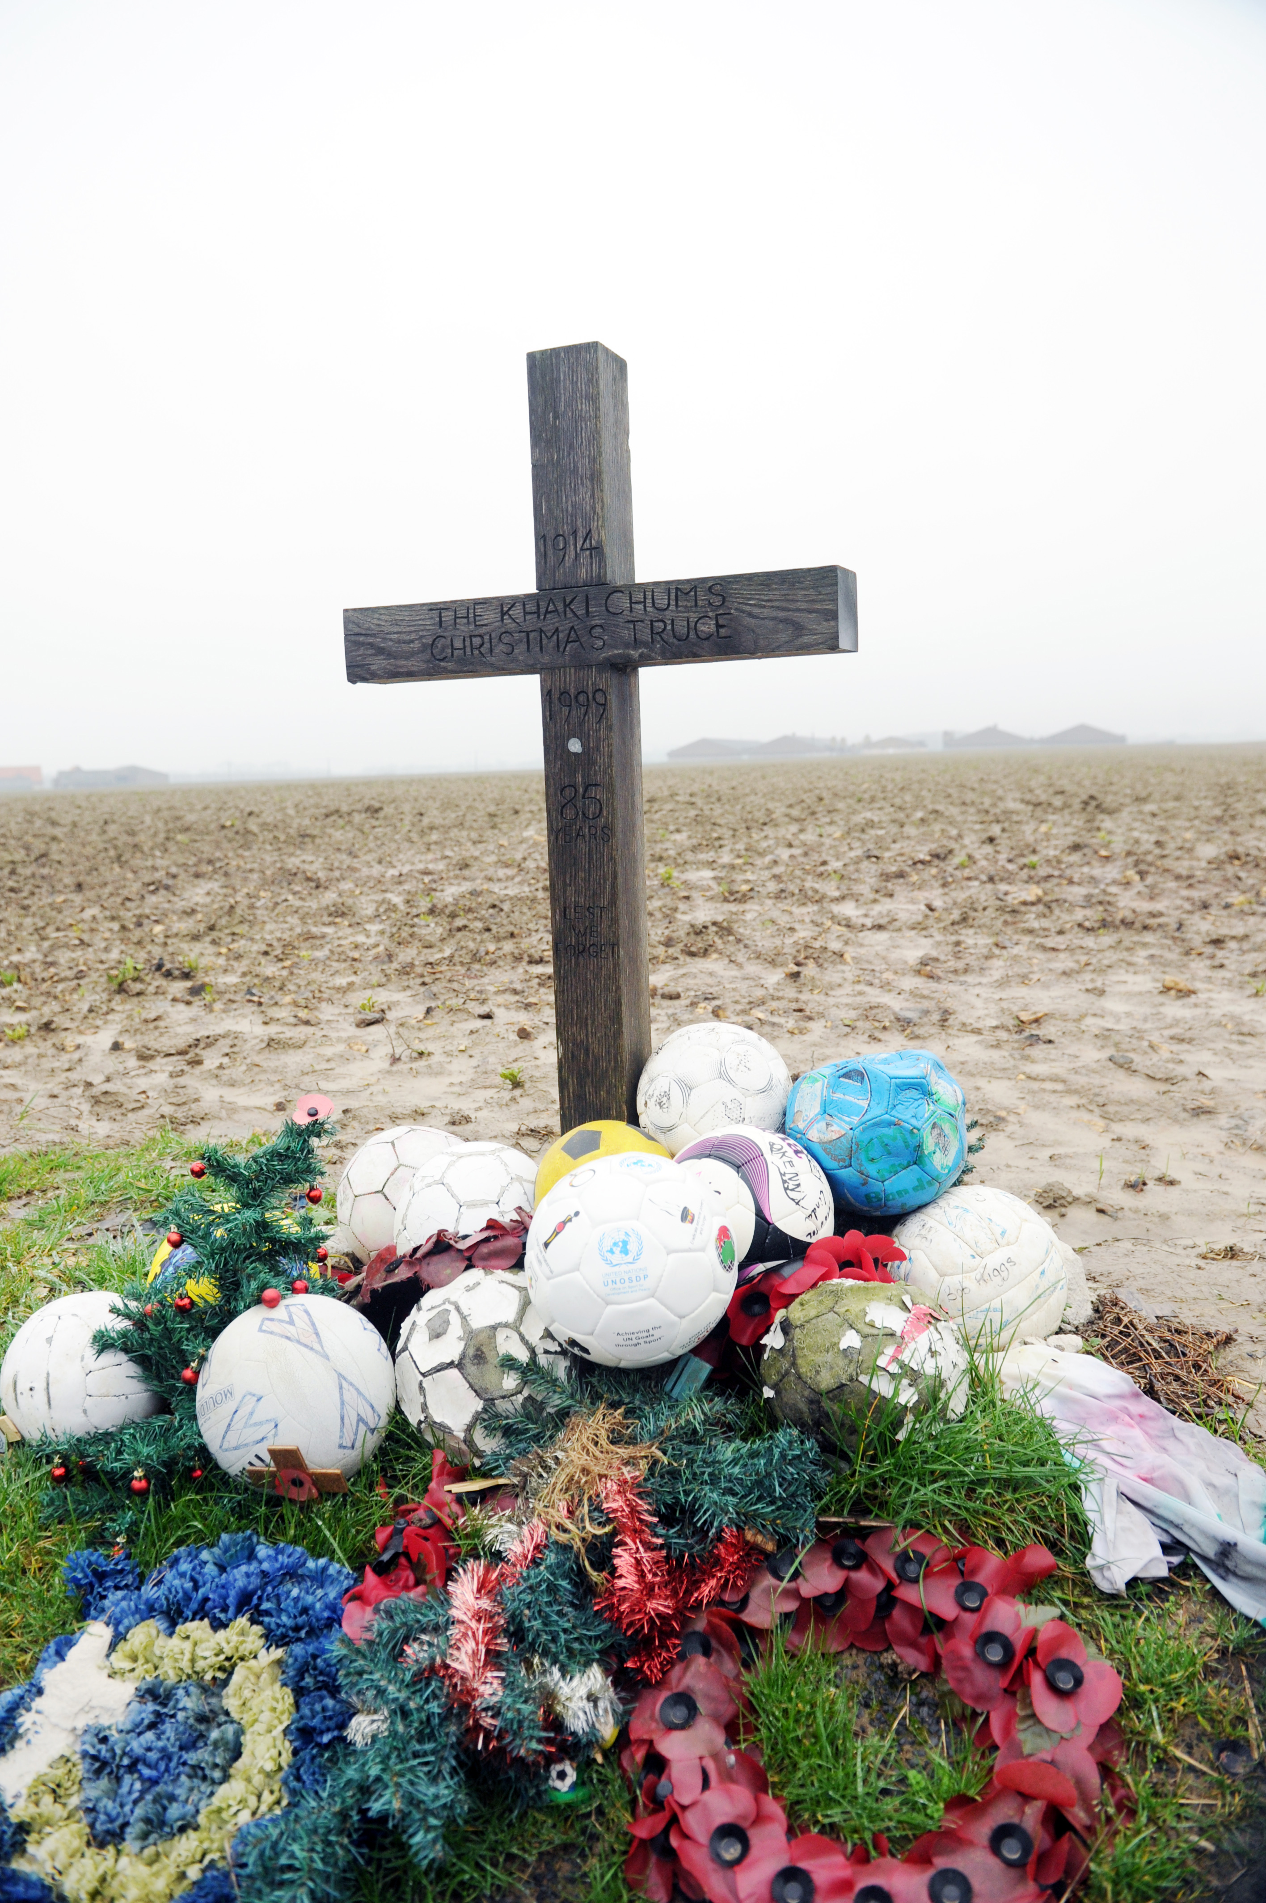

Peace Education
To commemorate the all wars and celebrate peace; The Global Peace Games (GPGs) brings young people together in a cultural exchange of learning. It enables young people to explore the role of play and sport; at home, in the community and in different countries; our global village.
An integral aspect to the GPGs will help contextualise young people’s perception of war. The GPGs will record their experiences and opinions, which they feel are relevant today - for future generations.
FLANDERS PEACE FIELD

Slide 5
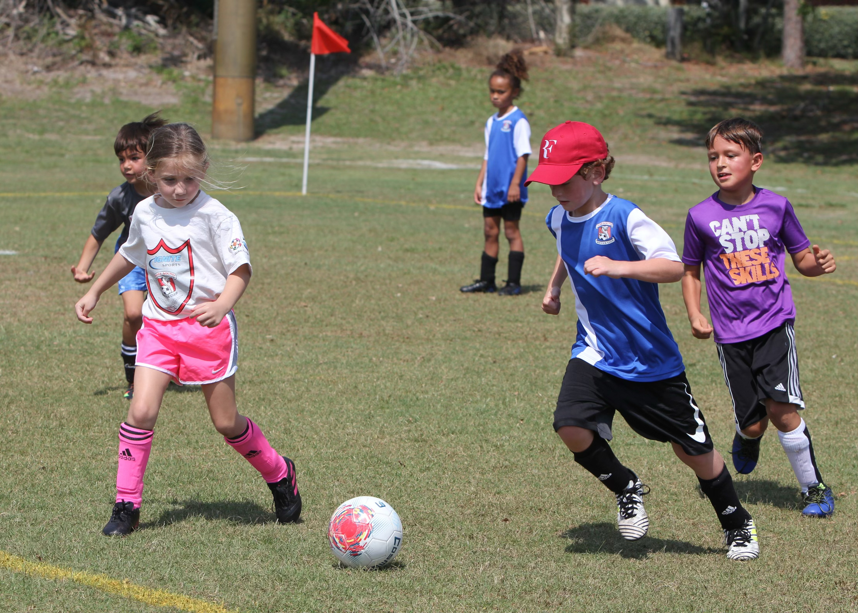
Peace Ambassadors
The Global Peace Games (GPGs) will create Peace Ambassadors for the future. Each participant will be expected to pledge a commitment to Peace and lobby their SCHOOL to host a peace event annually on the United Nations’ International Day of Peace, 21st September or an annual date relevant to the community. (Details will be provided on the course).
Each participant will receive a unique commemorative medal and a Peace Ambassador Certificate in recognition of their contribution to the GPGs. The certificate is an important contributory factor to your Curriculum Vitae and can be an important addition to your cross-curricular learning.

Slide 6


A CROSS- CURRICULAR PEACE EDUCATION
PROGRAMME THROUGH PLAY
Includes:
Cultural Games, Football, Cricket, Touch Rugby, Rounders, Bulldog, Basketball, Table Tennis, Cycling, Volley Ball
Workshops: Graffiti Art, Debating Skills, Interviews, Performance Art
Excursions: Christmas truces, Tyncott, Passchendaele, The Last Post, Ypres

Slide 7
EVENT DATES
Monday 16th Sept
Welcome to the GPGs
Tuesday 17th Sept
Commemoration Day
Wednesday 18th Sept
Peace Day Celebration
Thursday 19th Sept
Peace Field Day
Friday 20th Sept
International Day of Peace
Saturday 21st Sept
Football and Peace Day

Slide 8
Numbers
26 Participants (14-16 Years old)
Girls and Boys
Includes members of staff.
+ 30 Guest children

Slide 9
Accommodation and Food
All participants will stay at The Peace Village which is a peace education centre. All rooms accommodate 4 to 8 people.
There are 3 meals a day; breakfast, lunch & dinner. Please notify your member of staff as soon as possible of any dietary requirements.
Strict rules:
Do not bring laptops, consoles, jewellery, personal artefacts or inappropriate clothing. The CFA and Peace Village will not be responsible for replacing damaged or lost property.
Damage to property:
Any damage caused to The Peace Village property or facilities by any person or persons attending the GPGs will be held accountable to pay for the damage.

Slide 10
KIT LIST
Towels
Toiletries
Waterproof jacket + pants
Sportswear / shorts / top / trainers & football boots – NO BLADES
Walking shoes
Cycling helmets will be provided (however, if you wish to bring your own let your member of staff know)
Spending Money; a maximum 30 Euros to spend on souvenirs in Ypres
Mobile phones: All mobile phones are the responsibility of the owner.
The GPGs Policy concerning mobile phones: Participants must hand their phones to their teacher / staff before workshops, entering memorials and places of remembrance.

Slide 11

TRAVEL
Destination: Peace Village, Belgium, Nieuwkerkestraat 9, B-8957 leper, Belgium.
DEPART: To be confirmed
DATE:
ARRIVE
DATE:
ARRIVE PEACE VILLAGE, BELGIUM
RETURN:
DEPART: To be confirmed
DATE:
ARRIVE
DEPART:
ARRIVE

Slide 12

IMAGE CONSENT FORMS
All participants need their parents, guardians or carers to sign the image consent form before the trip and hand it in to their teacher / staff member. These forms can be obtained from the school’s teacher / staff project manager or downloaded from https://www.childrensfootballalliance.com/football-and-peace/global-peace-games/
The Global Peace Games will be filmed by the CFA. The short film will appear on the CFA’s Football & Peace website
Online links with the Peace Village / Flanders Peace Field and CFA’s Football & Peace website will provide access to view the film.
All associate partners will have GPGs featured on their respective social media platforms Football & Peace website.

Slide 13
Down load:
https://www.childrensfootballalliance.com/football-and-peace/global-peace-games/

Slide 14
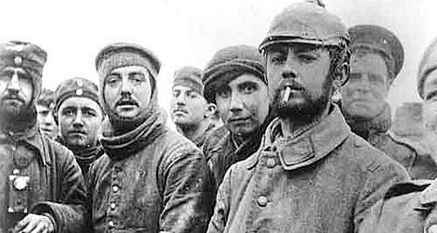
THE GIFT
The Christmas Truces. In the spirit of the Christmas Truces we ask that all Global Peace Games participants and members of staff, bring a small gift to exchange with your fellow peace makers at this year’s event.
The gift should be no more than €5. The gift could be something that represents your home, community or country.
WHY? Over a 100 years ago German and Allied soldiers took it upon themselves to rebel against the rules of engagement of in war. In an act of humanitarianism, they greeted each other in No-Man’s Land to exchange gifts. The act was a clear defiance of war and considered insubordination by both German and Allied Army’s governments.
HOW? You will be asked to ensemble at a meeting point where all the Global Peace Games participants and staff, will be introduced to one another through play.

Slide 15
EMERGENCY CONTACT NUMBERS
In case of any emergency contact the numbers listed below.
CFA Director Paul Cooper + 00 44 (0)7875 283093
Peace Village Director: Sally Meysman + 00 32 (0) 57 22 60 40
HSSC: Julie Hemsley: +1-603-236-6152
All members of staff will have a register of pupils emergency contact details. If there is an emergency at home parents, guardians and carers, must contact the CFA in the first instance.
http://www.childrensfootballalliance.com/football-and-peace/

Slide 16
Have you signed the REGISTER?
All parents and participants
must sign the
GPGS 2025
PRESENTATION REGISTER

