Slide 1

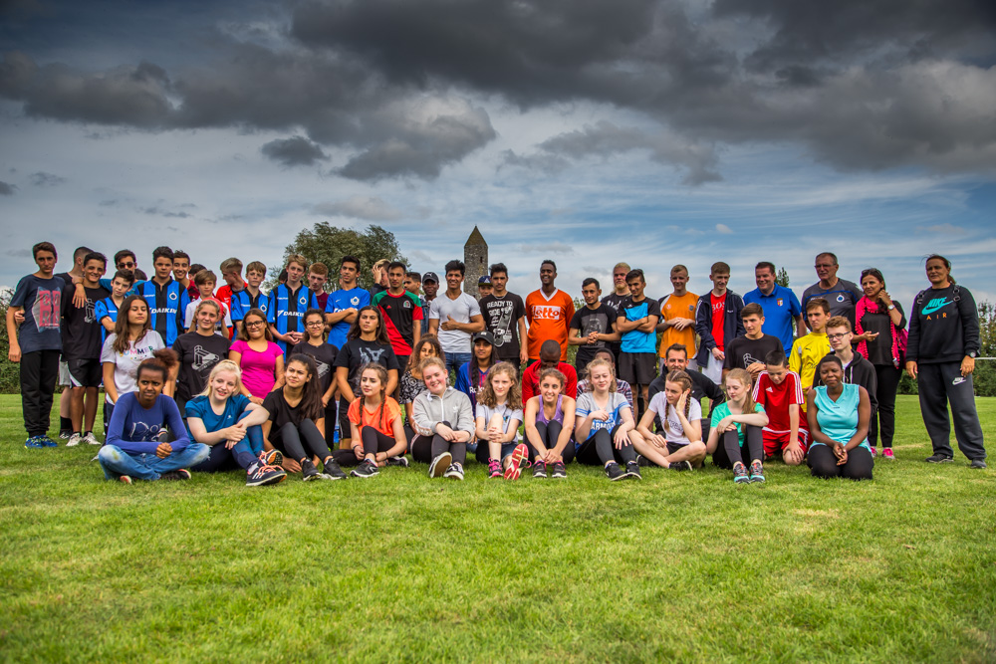

Voorstelling
Global Peace Games

Slide 2
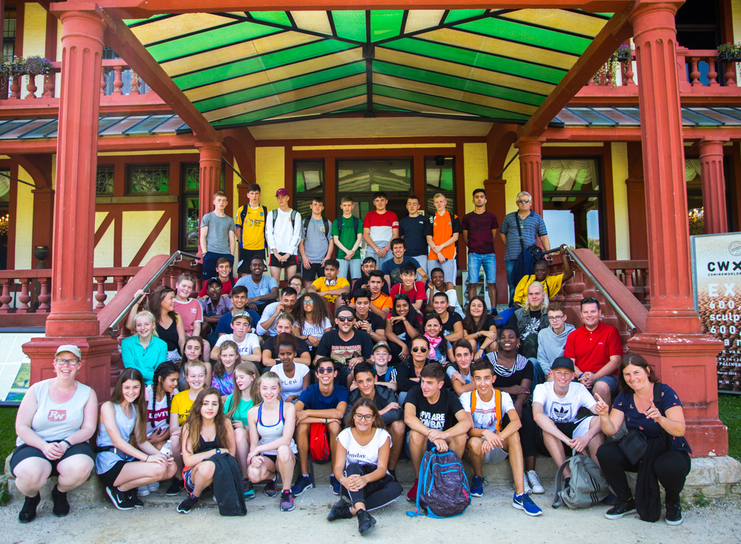
Project in het kort:
6-daagse internationale uitwisseling in Peace Village Mesen
80 deelnemers + 10 begeleiders
Meer dan 16 nationaliteiten
Thema:
vrede en conflicthantering
interculturele dialoog
verbindende kracht van sport en spel
Organisatie door Britse vzw CFA

Slide 3
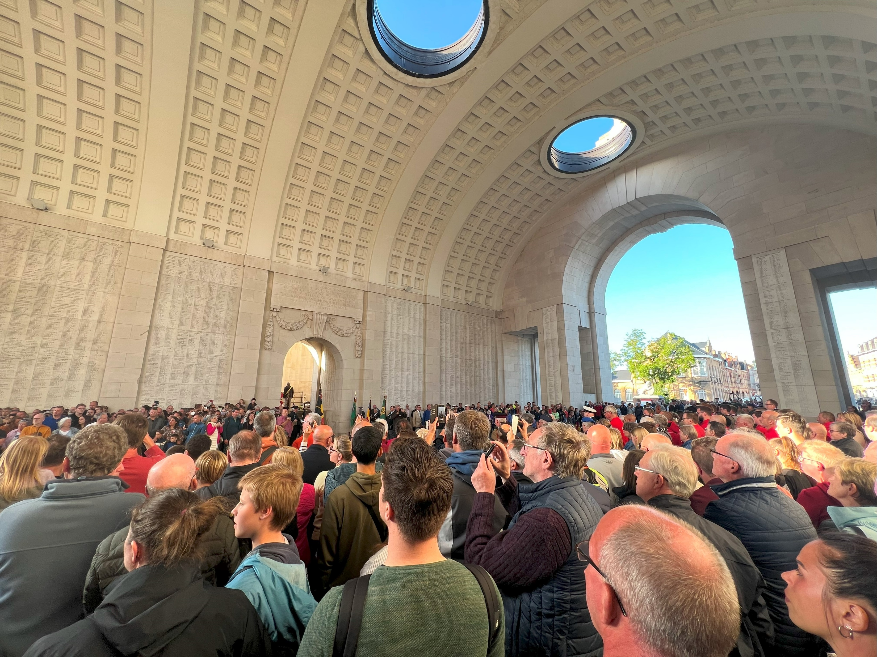
Project in het kort:
België en de Eerste Wereldoorlog. Toen de internationale spanningen in de zomer van 1914 toenamen, maakte Duitsland plannen om Frankrijk te belegeren door Luxemburg en België over te steken, ondanks hun neutraliteit. De twee landen weigerden de Duitse troepen vrije doorgang en werden op 2 en 4 augustus binnengevallen.

Slide 4
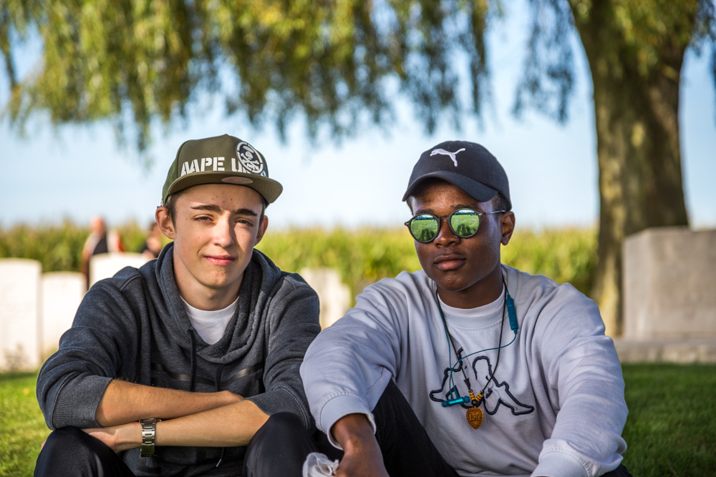
Programma inhoudelijk
Sport en spel
Workshops (artistiek, inhoudelijk, muzikaal)
Bezoek aan historische plaatsen (Tyne Cot, Passendaele Museum, Iers vredespark, Last Post, …)

Slide 5



GLOBAL PEACE GAMES
2024
The GPGs is linked to Peace Fields Projects which aims to twin school playing fields with Flanders Peace Field.
The Peace Field Project GPGs is funded by The Children’s Football Alliance.
Countries taking part: Belgium and USA
Special guests:
Bruges FC (Belgium) children.

Slide 6
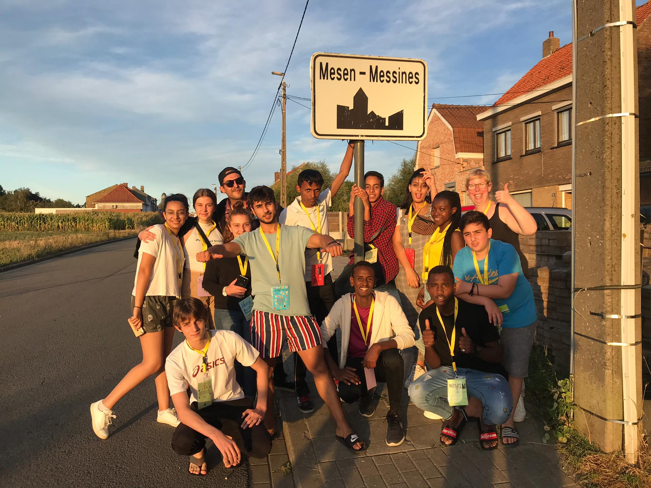
Inbreng Groep INTRO
20 deelnemers uit vrijetijdswerkingen Vlaanderen / BXL
Focus op ex-OKAN jongeren => meerwaarde in programma
4 professionele jeugdwerkers + 1 vrijwilliger
Actieve rol in voorbereiding programma

Slide 7
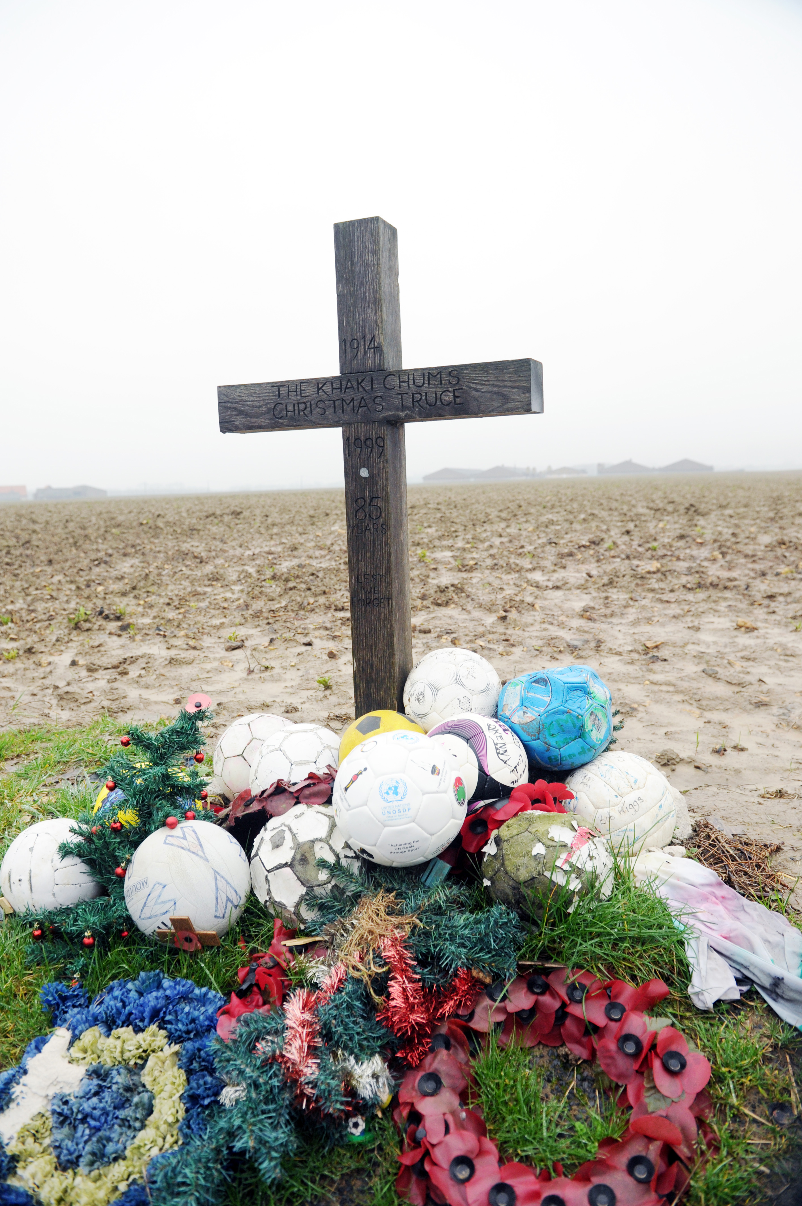


Peace Education
To commemorate the all wars and celebrate peace; The Global Peace Games (GPGs) brings young people together in a cultural exchange of learning. It enables young people to explore the role of play and sport; at home, in the community and in different countries; our global village.
An integral aspect to the GPGs will help contextualise young people’s perception of war. It will record their experiences and opinions, which they feel are relevant today - for future generations.
FLANDERS PEACE FIELD

Slide 8
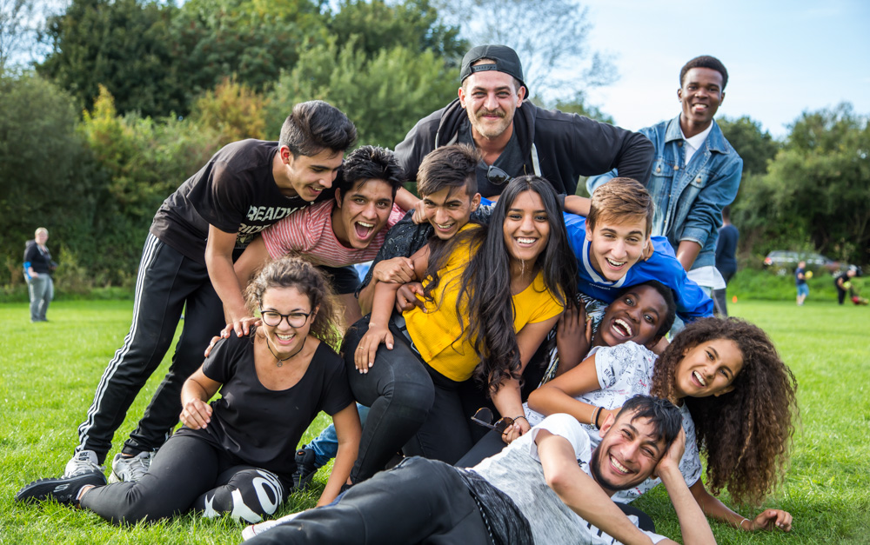
Impact
Deelnemers gaan naar huis als ‘peace ambassadors’ -> lokale impact op school, thuis, …
Jongeren ervaren kracht van diversiteit en interculturaliteit -> positieve identiteitsontwikkeling
Deelnemers leren historische plaatsen in Vlaanderen kennen en delen onze geschiedenis -> integratie
Zeer sterke en veelzijdige partnerschap (4de editie) met partners CFA, Peace Village en Groep INTRO. -> ‘best practice’ internationaal samenwerking

Slide 9
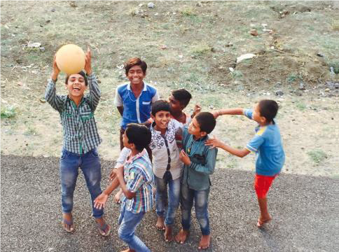
Peace Ambassadors
The Global Peace Games (GPGs) will create Peace Ambassadors for the future. Each participant will be expected to pledge a commitment to Peace and lobby their SCHOOL to host a peace event annually on the United Nations’ International Day of Peace, 21st September or an annual date relevant to the community. (Details will be provided on the course).
Each participant will receive a unique commemorative medal and a Peace Ambassador Certificate in recognition of their contribution to the GPGs. The certificate is an important contributory factor to your Curriculum Vitae and can be used in gaining further education places and employment vacancies

Slide 10
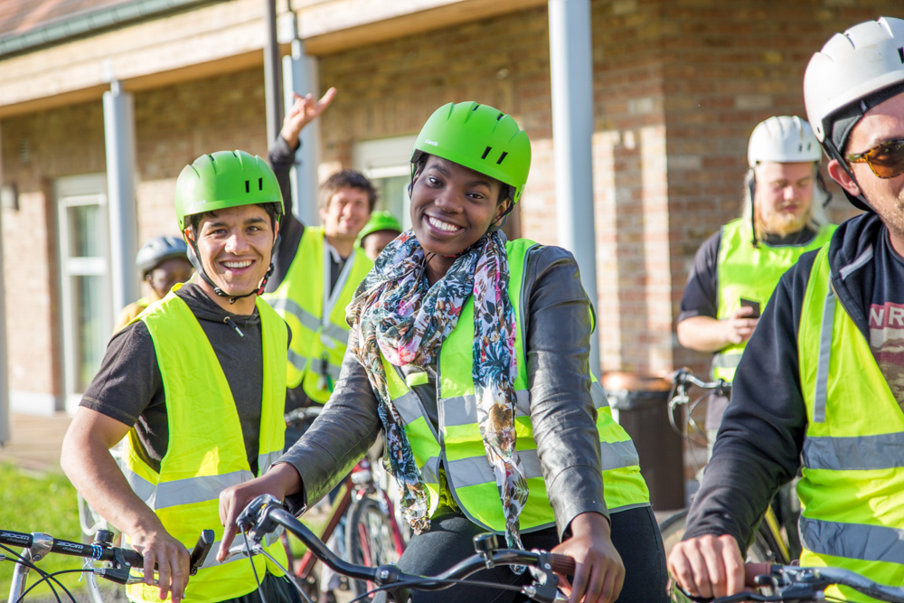

Slide 11

A CROSS- CURRICULAR PEACE EDUCATION
PROGRAMME THROUGH PLAY
Includes:
Cultural Games, Football, Cricket, Touch Rugby, Rounders, Bulldog, Basketball, Table Tennis, Cycling, Volley Ball
Workshops: Graffiti Art, Debating Skills, Interviews, Performance Art
Excursions: Tyncott, Passchendaele, The Last Post, Ypres

Slide 12
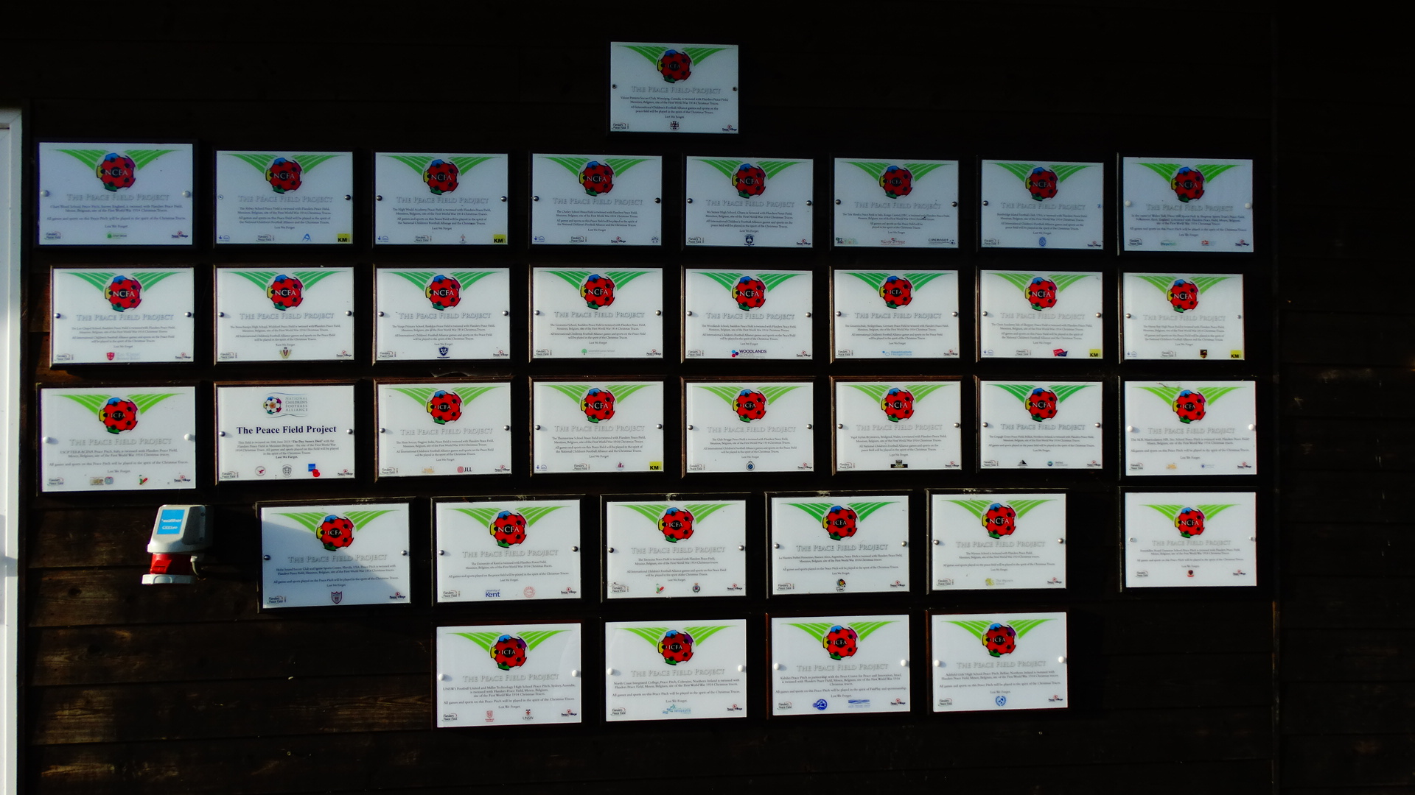

Slide 13
EVENT DATES
Monday 16th Sept
Welcome to the GPGs
Tuesday 17th Sept
Commemoration Day
Wednesday 18th Sept
Peace Day Celebration
Thursday 19th Sept
Peace Field Day
Friday 20th Sept
International Day of Peace
Saturday 21st Sept
Football and Peace Day

Slide 14
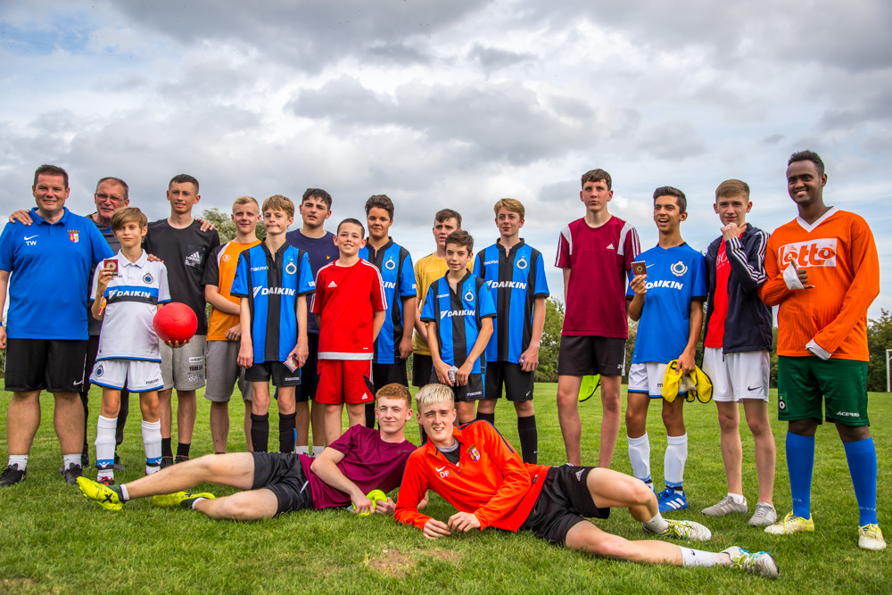

Slide 15
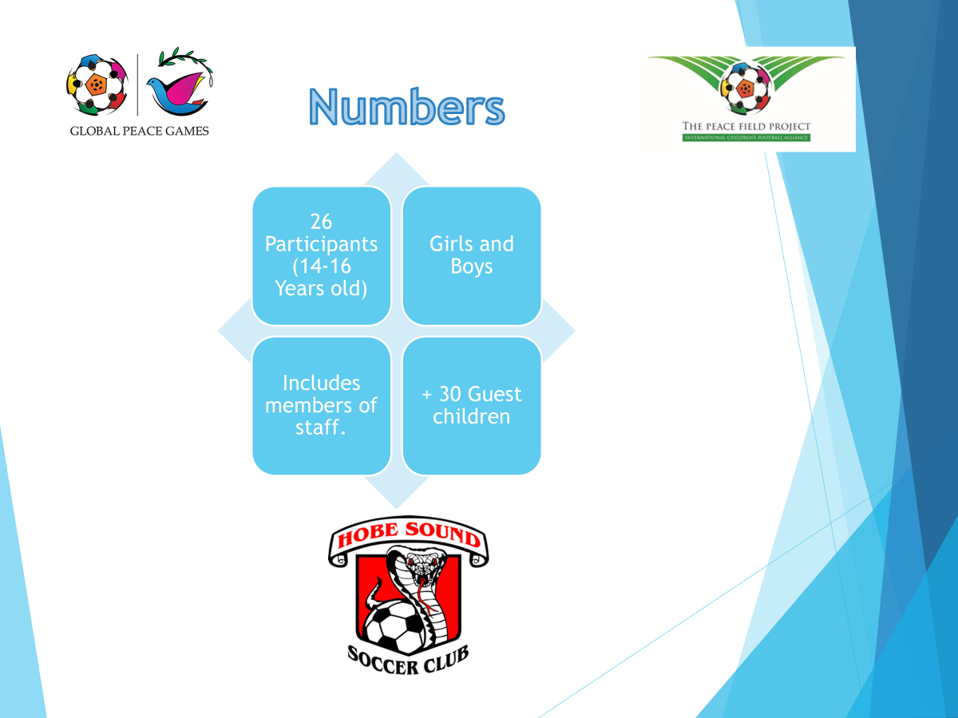


Slide 16
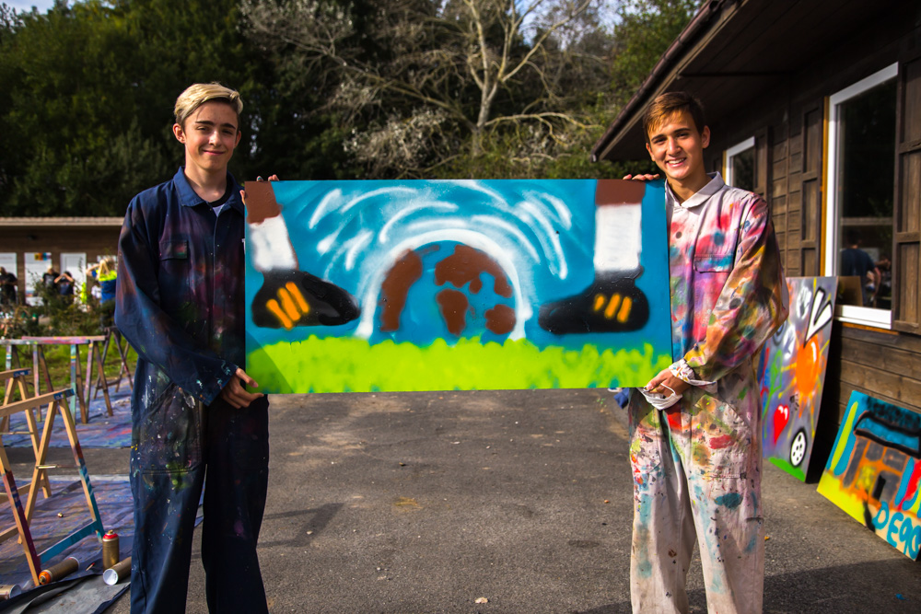

Slide 17

Accommodation and Food
All participants will stay at The Peace Village which is a peace education centre. All rooms accommodate 4 to 8 people.
There are 3 meals a day; breakfast, lunch & dinner. Please notify your member of staff as soon as possible of any dietary requirements.
Strict rules:
Do not bring laptops, consoles, jewellery, personal artefacts or inappropriate clothing. The CFA and Peace Village will not be responsible for replacing damaged or lost property.
Damage to property:
Any damage caused to The Peace Village property or facilities by any person or persons attending the GPGs will be held accountable to pay for the damage.

Slide 18
KIT LIST
Towels
Toiletries
Waterproof jacket + pants
Sportswear / shorts / top / trainers & football boots – NO BLADES
Walking shoes
Cycling helmets will be provided (however, if you wish to bring your own let your member of staff know)
Spending Money; a maximum 30 Euros to spend on souvenirs in Ypres
Mobile phones: All mobile phones are the responsibility of the owner.
The GPGs Policy concerning mobile phones: Participants must hand their phones to their teacher / staff before workshops, entering memorials and places of remembrance.

Slide 19

TRAVEL
Destination: Peace Village, Belgium, Nieuwkerkestraat 9, B-8957 leper, Belgium.
DEPART:
DATE:
ARRIVE
DATE:
ARRIVE
RETURN:
DEPART
DATE:
ARRIVE
DEPART:
ARRIVE

Slide 20

IMAGE CONSENT FORMS
All participants need their parents, guardians or carers to sign the image consent form before the trip and hand it in to their teacher / staff member. These forms can be obtained from the school’s teacher / staff project manager.
The Global Peace Games will be filmed by the CFA. The short film will appear on the CFA’s Football & Peace website
Online links with the Peace Village / Flanders Peace Field and CFA’s Football & Peace website will have access to view the film.
All associate partners will have GPGs featured on their respective social media platforms Football & Peace website.

Slide 21
SAMPLE
Down load:
https://www.childrensfootballalliance.com/football-and-peace/global-peace-games-2025/

Slide 22
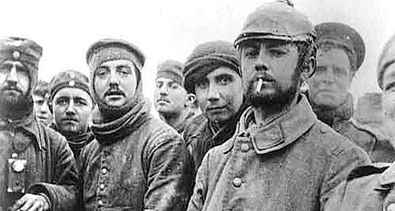
THE GIFT
The Christmas Truces. In the spirit of the Christmas Truces we ask that all Global Peace Games participants and members of staff, bring a small gift to exchange with your fellow peace makers at this year’s event.
The gift should be no more than €5. The gift could be something that represents your home, community or country.
WHY? Over a 100 years ago German and Allied soldiers took it upon themselves to rebel against the rules of engagement of in war. In an act of humanitarianism, they greeted each other in No-Man’s Land to exchange gifts. The act was a clear defiance of war and considered insubordination by both German and Allied Army’s governments.
HOW? You will be asked to ensemble at a meeting point where all the Global Peace Games participants and staff, will be introduced to one another.

Slide 23
EMERGENCY CONTACT NUMBERS
In case of any emergency contact the numbers listed below.
CFA Director Paul Cooper + 00 44 (0)7875 283093
Peace Village Director: Sally Meysman + 00 32 (0) 57 22 60 40
GroepINTRO: Virginie Bauveroy : +32 472 80 02 52
All members of staff will have a register of pupils emergency contact details. If there is an emergency at home parents, guardians and carers, must contact the CFA in the first instance.
http://www.childrensfootballalliance.com/football-and-peace/

Slide 24
Have you signed the REGISTER?
All parents and participants
must sign the
GPGS 2024
PRESENTATION REGISTER

Slide 25



Ter info:
2024 GLOBAL PEACE GAMES, FILM, EXECUTIVE SUMMARY AND EVALUATION REPORT
Contact:
Virginie Bauveroy Stafmedewerker jongeren Dienst O3 (Ondersteuning – Onderzoek – Ontwikkeling) Virginie.Bauveroy@groepintro.be
Groep INTRO vzw Charles Parentéstraat 6 1070 Brussel | +32 (0)2 242 85 43 +32 (0)473 54 59 75

